Slide 1
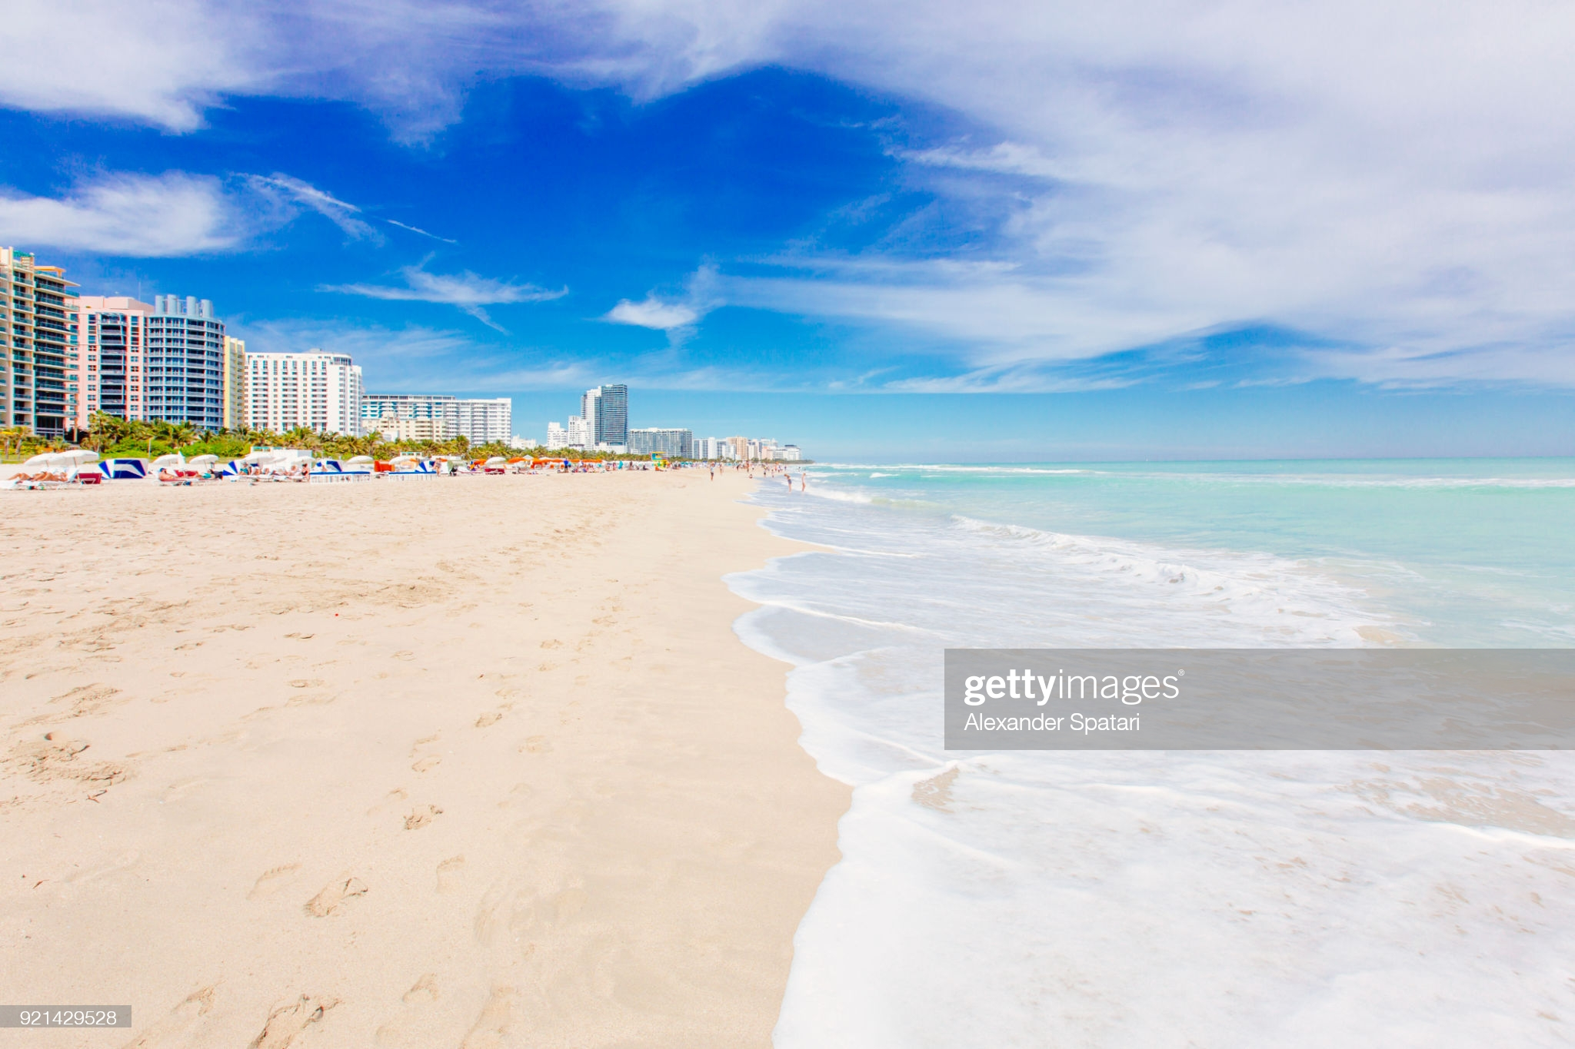
My Weekend in Miami
Rajat Thaker
Cody Thornton,
Brock Whitbread-Cole,
Tara Panzarino

Slide 2
Miami, Florida is one of the top travel destinations in the United States. As a domestic travel location, Miami is suitable for brief weekend getaways. Our application allows busy travelers to conveniently plan a short itinerary based on their budget and interests.
https://vast-falls-09879.herokuapp.com/

Slide 3

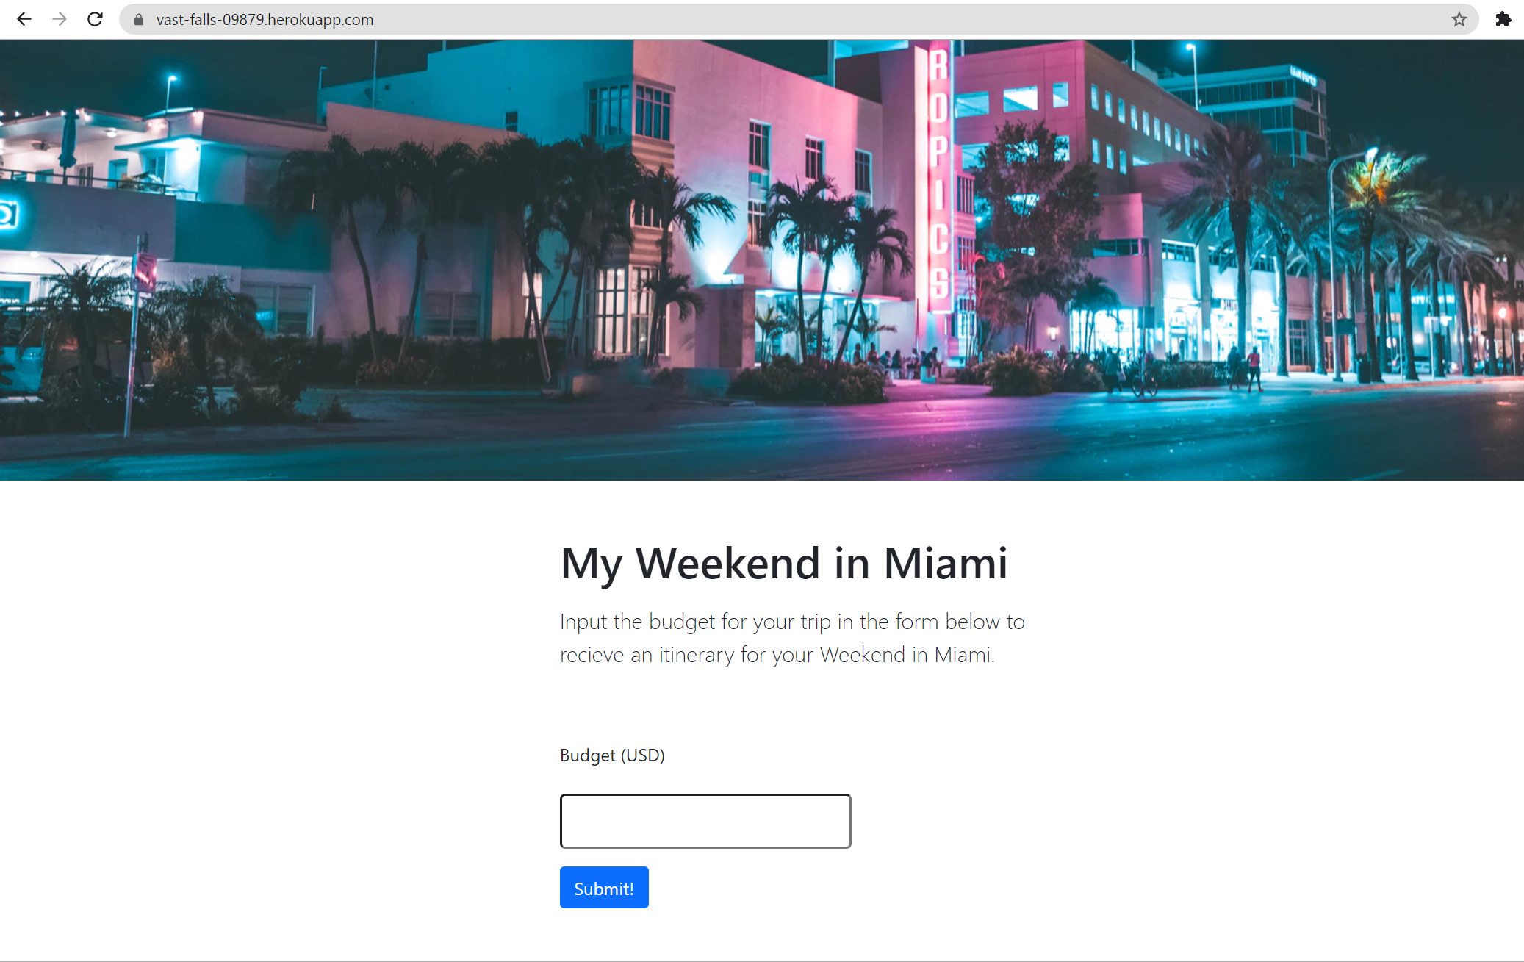

Slide 4
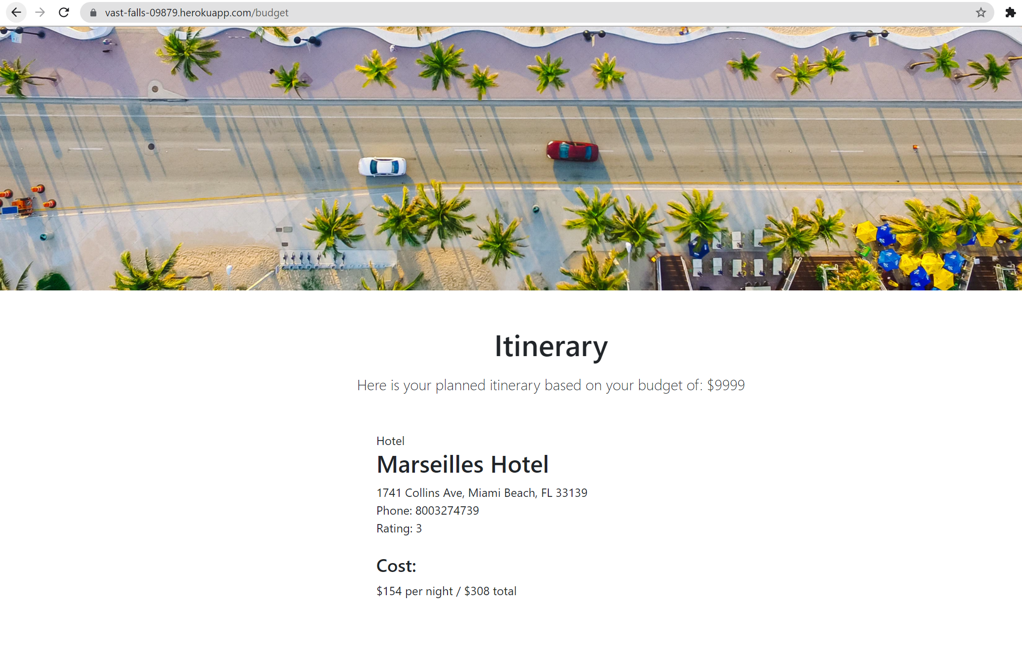

Slide 5
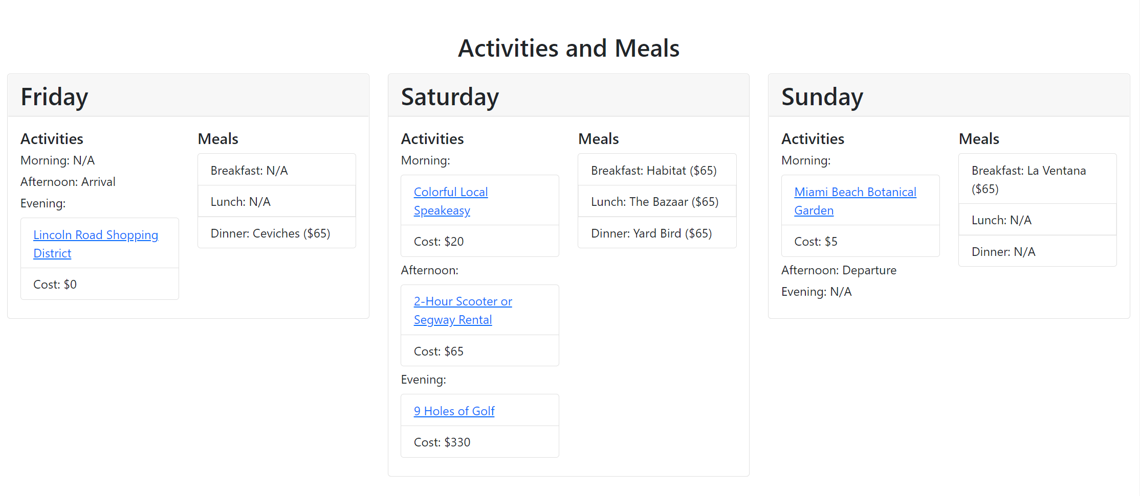

Slide 6
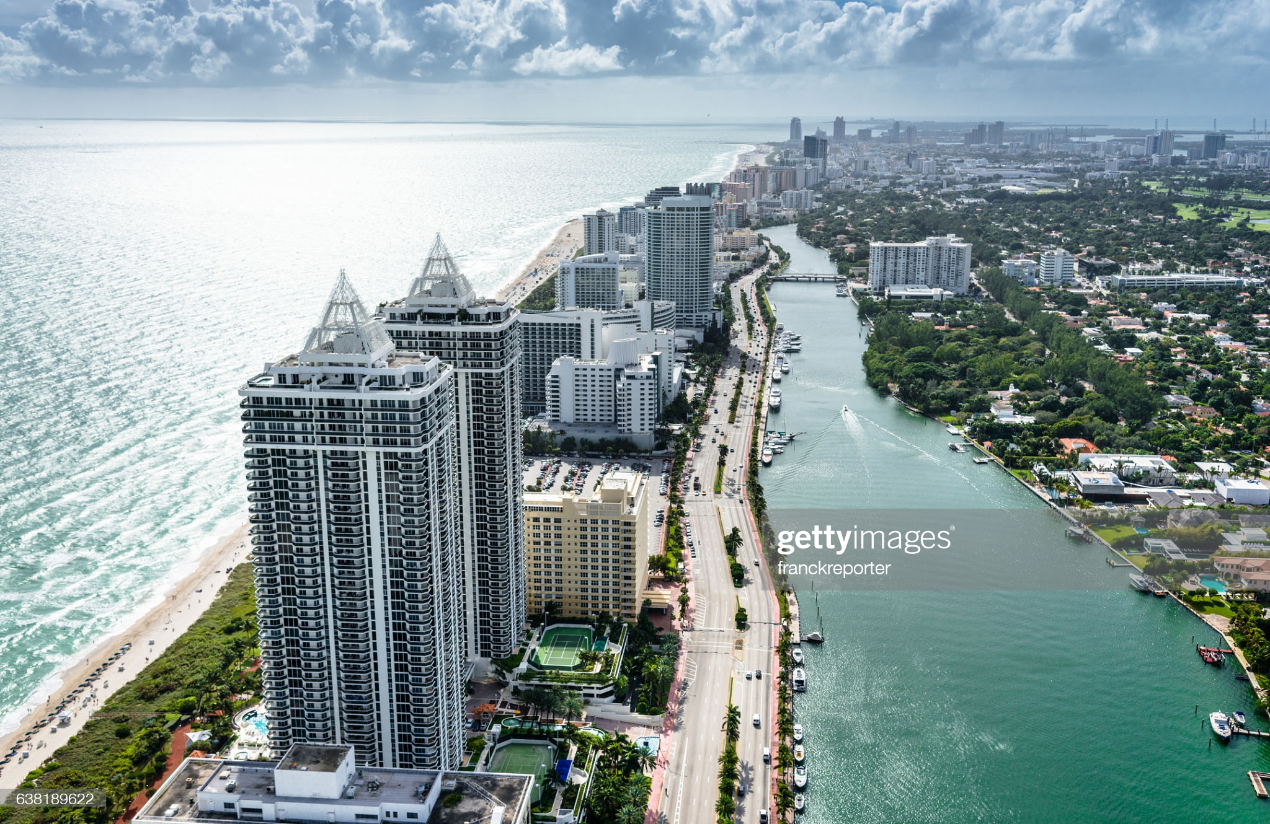

Tools

Slide 7
Github for Version Control and Project Tracking
Teammates make edits within own branch during earlier stages of project
Remain focused on separate goals
Merged separate branches into “staging” branch to test project deployment and make necessary edits
Team Evaluation: Excellent
Tara

Slide 8
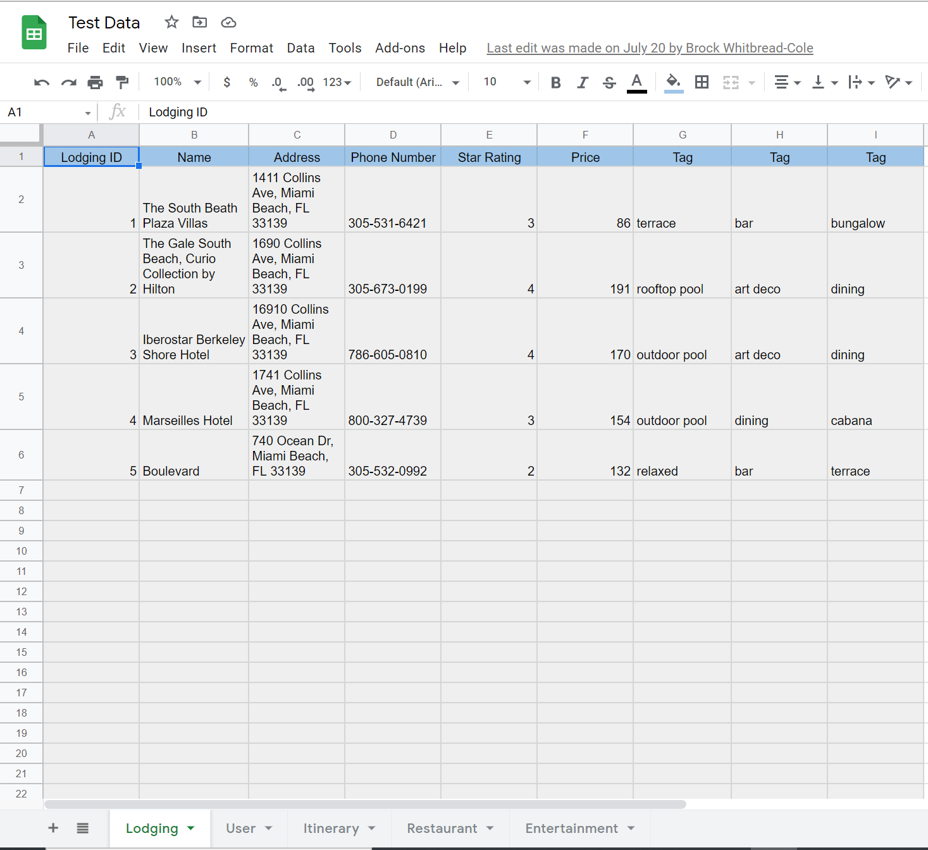
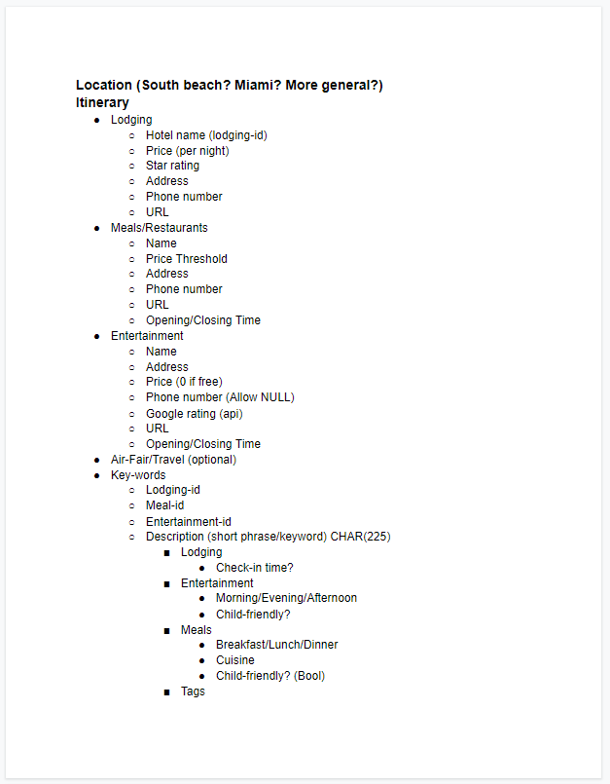
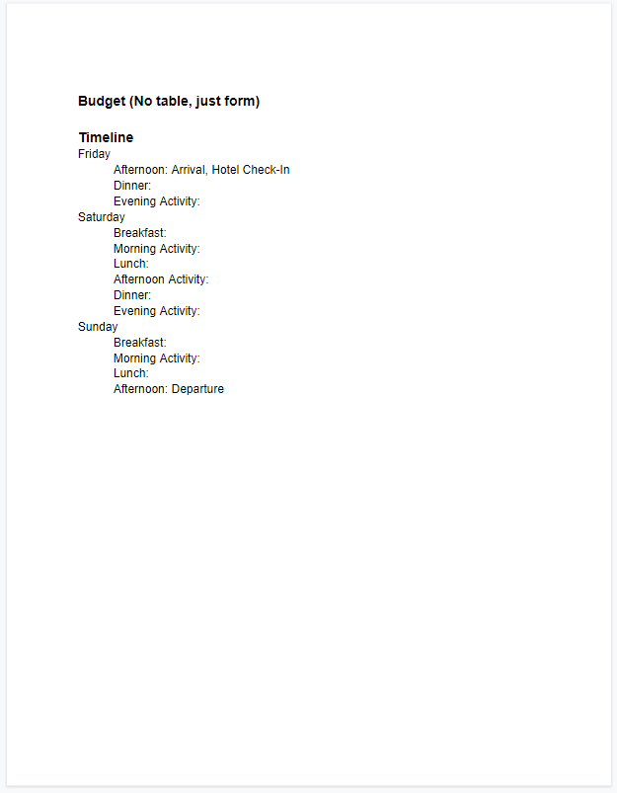
Google Drive for Project Tracking
Initial project schema
Single location to collect Restaurant, Hotel, and Entertainment raw data
Team evaluation: Good
Tara
Notes:
TARA END

Slide 9
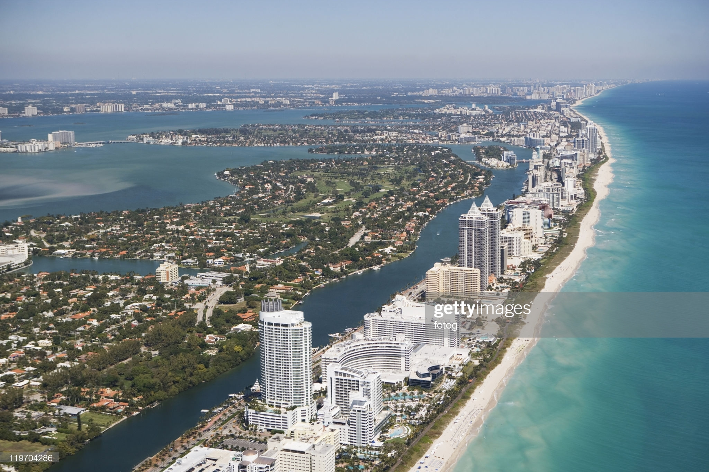
SQLite3
Able to store database of Entertainment, Restaurant, and Hotel items
Selections based on user specified attributes
cost, rating, etc.
Ability to add more items to database in the future or utilize tags
Team Evaluation: Good
More complex syntax
Compatibility issues with Heroku deployment
Not intended for long-term use
Rajat

Slide 10

Unittest Unit Testing Framework
Consistent testing over hotel, restaurant, entertainment, and budget
Easy visibility of Errors and Exceptions
Team evaluation: Excellent

Slide 11

Programming Languages
Python
Backend
Hotel, Restaurant, Entertainment, Budget and Itinerary setup
HTML/CSS
Frontend
SQL
Database interaction
Team evaluation: Good
Cody

Slide 12
Flask Framework
Easy routing
Utilizes simple Python syntax
Ability to code in separate modules
Bootstrap Framework
Base template
Templates
Welcome, budget, itinerary, etc.
Team Evaluation: Excellent
Cody

Slide 13

Code Editors
Visual Studio Code
Atom
Vim
We “love” vim
Team Evaluation: Good

Slide 14
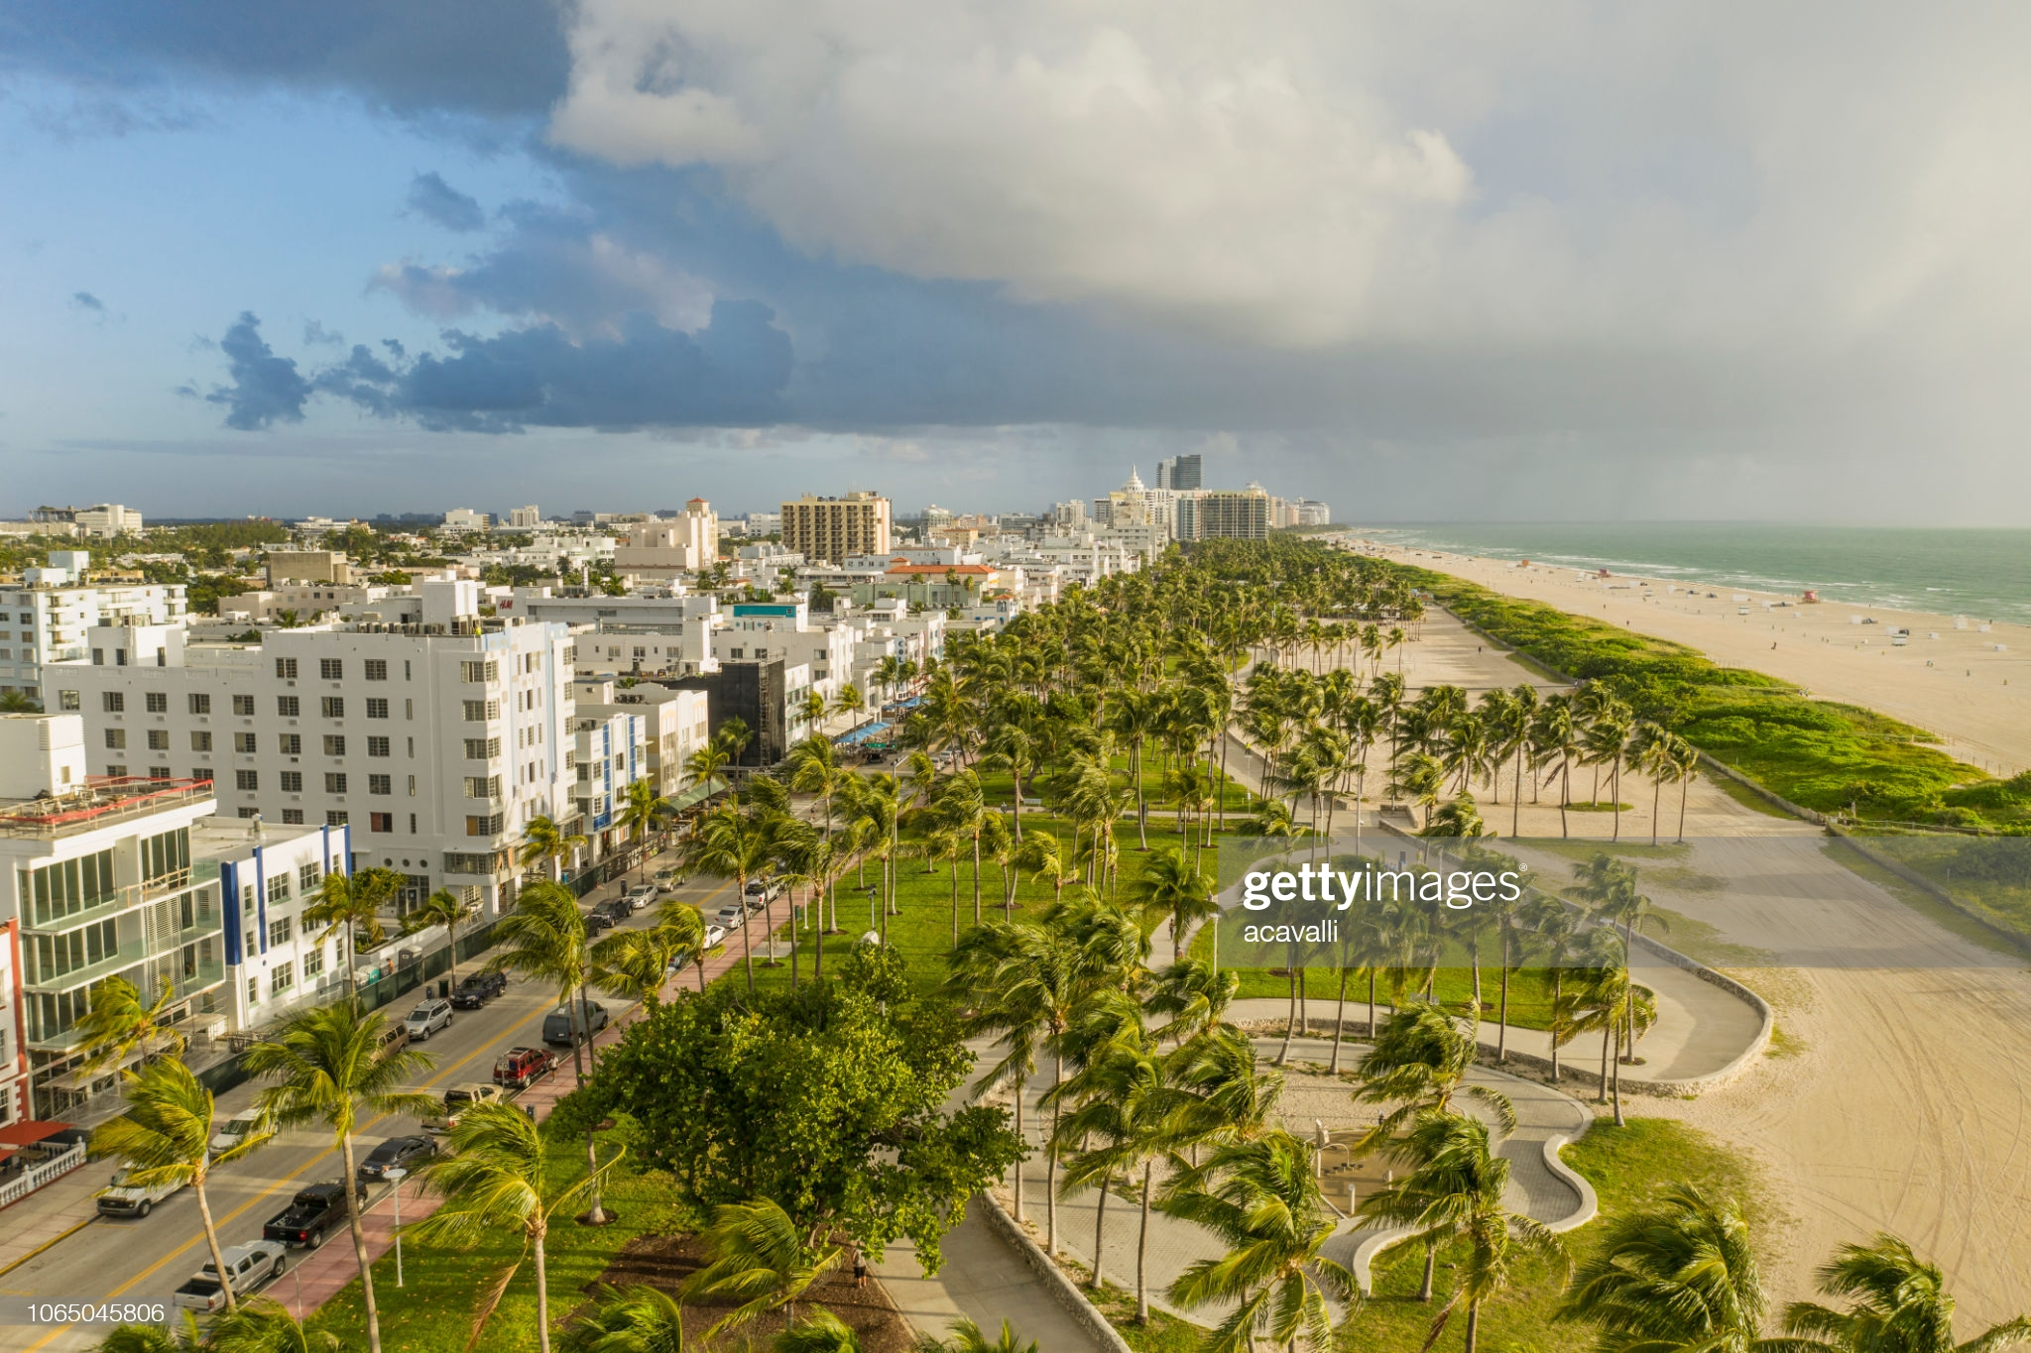
Heroku Deployment
Easy deployment
Compatibility issues with SQL
Team Evaluation: Good
Brock

Slide 15

Challenges
Remote Class
Scheduling
Team remained goal-focused
Excelled given time constraints and project scope
Utilized class topics
Thanks Cody ☺
Initial lack of experience for some team members:
HTML/CSS
Flask
Sqlite3
Unittest
Github
Heroku

Slide 16
PROJECT DEMONSTRATION

